Slide 1

Wired and Wireless networks
By Maison Roberts

Slide 2

2.1 The Internet
The Internet is a worldwide collection of connected networks not managed by one group of people but can be accessed by anyone
The internet is not the same thing as the World Wide Web [WWW]. Website’s are stored on web servers and are connected the internet and each one has a unique web address allowing it to be accessed. Every thing on the World Wide Web is stored in documents know as web pages These can accessed from any web browser such as Firefox, Google Chrome and Opera

Slide 3

IP Addressing
Every networked computer or computing device in the world has a separate unique IP address such as the school’s IP is 5.150.103.64 This is part of IPV4 System. IP Stands for Internet Protocol and an IP Version 4 address can take the form of : 65.123.217.14 or 5.150.103.64 but there our other types of IP Protocols such as IPV6 as it is predicted we will run out of IPV4 Address’ so the new IPV6 will be replacing it

Slide 4
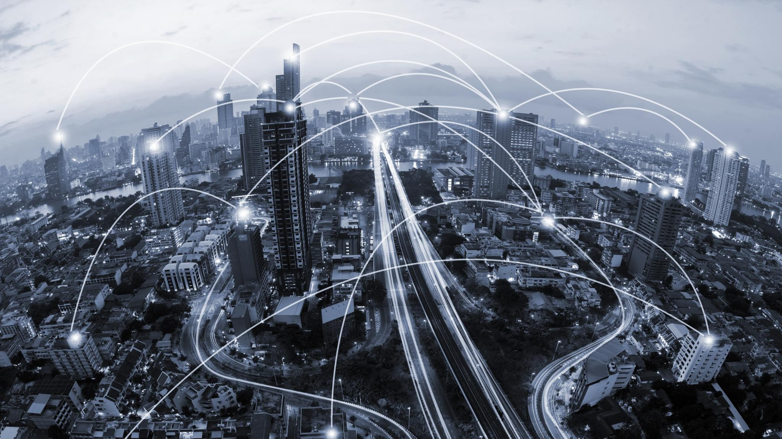
Domain Name Systems
Websites are stored on webservers

